Slide 1
Windows Kernel Internals
Object Manager & LPC
Dave Probert, Ph.D.
Advanced Operating Systems Group
Windows Core Operating Systems Division
Microsoft Corporation

Slide 2
Kernel Object Manager (OB)
Provides underlying NT namespace
Unifies kernel data structure referencing
Unifies user-mode referencing via handles
Simplifies resource charging
Central facility for security protection

Slide 3
\ObjectTypes
Adapter
Callback
Controller
DebugObject
Desktop
Device
Directory
Driver
Event
EventPair
File
IoCompletion
Job
Key
KeyedEvent
Mutant
Port
Process
Profile
Section
Semaphore
SymbolicLink
Thread
Timer
Token
Type
WaitablePort
WindowsStation
WMIGuid

Slide 4
\ObjectTypes
Adapter
Callback
Controller
DebugObject
Desktop
Device
Directory
Driver
Event
EventPair
File
IoCompletion
Job
Key
KeyedEvent
Mutant
Port
Process
Profile
Section
Semaphore
SymbolicLink
Thread
Timer
Token
Type
WaitablePort
WindowsStation
WMIGuid

Slide 5
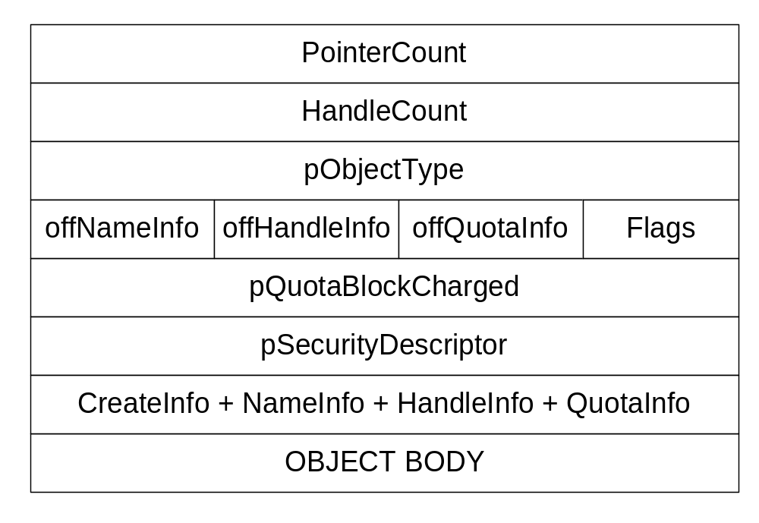
OBJECT_HEADER

Slide 6
Generic object services
namespace ops: directories, symlinks
NtQueryObject
NtQuery/SetSecurityObject
NtWaitForSingle/MultipleObjects
ObOpenObjectByName/Pointer
ObReferenceObjectbyName/Handle
NtDuplicateObject
NtClose
ObDereferenceObject

Slide 7
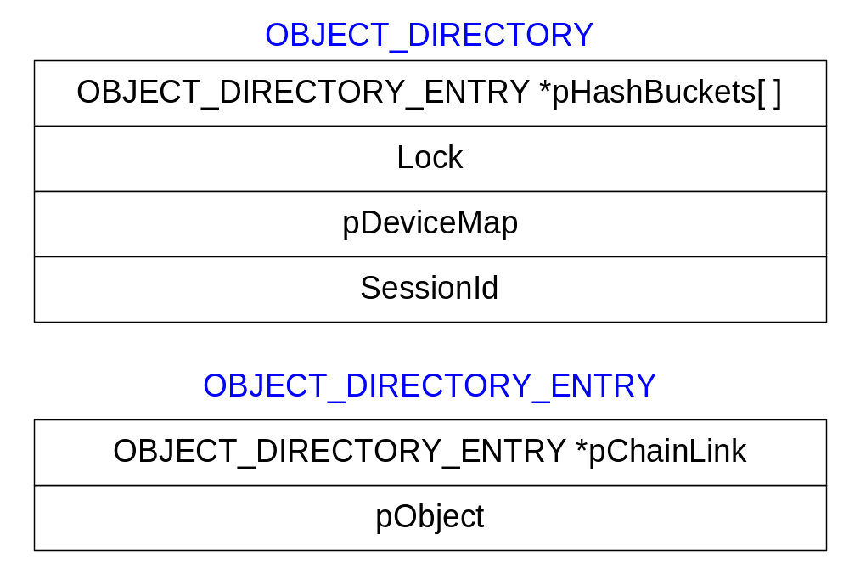
OBJECT_DIRECTORY

Slide 8
ObpLookupDirectoryEntry(pD, s)
object = NULL
idx = HASH(s)
pE = pD->HashBuckets[idx]
LockDirectoryShared(pD)
while (pE && !eqs(s, pE->Object->Name))
  pE = pE->pChainLink
if (pE)
  ObpReferenceObject(object = pE->Object)
UnlockDirectory(pD)
return object

Slide 9
Object Methods
OPEN: Create/Open/Dup/Inherit handle
CLOSE: Called when each handle closed
DELETE: Called on last dereference
PARSE: Called looking up objects by name
SECURITY: Usually SeDefaultObjectMethod
QUERYNAME: Return object-specific name
OKAYTOCLOSE: Give veto on handle close

Slide 10
Object Manager Types
Directory - namespace object
    Implementation hardwired
SymbolicLink - namespace object
    DeleteProcedure = ObpDeleteSymbolicLink
    ParseProcedure = ObpParseSymbolicLink
Type - represent object types
    DeleteProcedure = ObpDeleteObjectType

Slide 11
Object Manager lookups
ObpLookupObjectName(Name,Context)
  Search a directory for specified object name
  Use ObpLookupDirectoryEntry() on Directories
  Otherwise call object-specific ParseProcedure
    Implements symbolic links (SymbolicLink type)
    Implements file systems (DeviceObject type)

Slide 12
I/O Manager Types
Adapter - ADAPTER_OBJECT
Controller - CONTROLLER_OBJECT
Device - DEVICE_OBJECT
ParseProcedure = IopParseDevice
    DeleteProcedure = IopDeleteDevice
    SecurityProcedure = IopGetSetSecurityObject
Driver - DRIVER_OBJECT
    DeleteProcedure = IopDeleteDriver
IoCompletion - KQUEUE
    DeleteProcedure = IopDeleteIoCompletion

Slide 13
I/O Manager File Type
File - FILE_OBJECT
    CloseProcedure = IopCloseFile
    DeleteProcedure = IopDeleteFile
    ParseProcedure = IopParseFile
    SecurityProcedure = IopGetSetSecurityObject
    QueryNameProcedure = IopQueryName

Slide 14
IopParseDevice
(DeviceObject, Context, RemainingName)
  Call SeAccessCheck()
  If (!*RemainingName) directDeviceOpen = TRUE
  For file opens, get Volume from DeviceObject
  Update references on Volume and DeviceObject
  Construct an I/O Request Packet (IRP)
  FileObject = ObCreateObject(IoFileObjectType)
  Initialize FileObject
  Initiate I/O via IoCallDriver(VolumeDevice, IRP)
  Wait for I/O to signal FileObject->Event
  Return the FileObject to caller

Slide 15
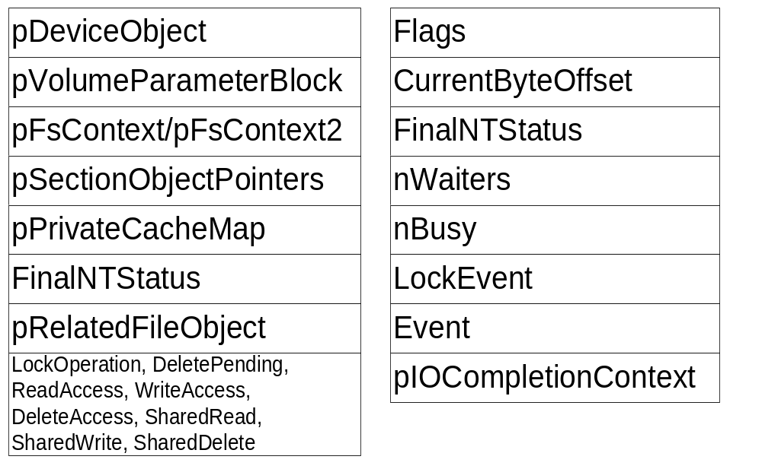
FILE_OBJECT

Slide 16
Process/Thread Types
Job - JOB
    DeleteProcedure = PspJobDelete
    CloseProcedure = PspJobClose
Process - EPROCESS
    DeleteProcedure = PspProcessDelete
Profile - EPROFILE
    DeleteProcedure = ExpProfileDelete
Section - SECTION
    DeleteProcedure = MiSectionDelete
Thread - ETHREAD
    DeleteProcedure = PspThreadDelete
Token - TOKEN
    DeleteProcedure = SepTokenDeleteMethod

Slide 17
Job methods - Close
PspJobClose - called by OB when a handle is closed
  Return unless final close
  Mark Job as closed
  Acquire the job's lock
  If job marked PS_JOB_FLAGS_CLOSE_DONE
    Release the JobLock
    Call PspTerminateAllProcessesInJob()
    Reacquire the JobLock
  Acquire the job's MemoryLimitsLock
  Remove any completion port from the job
  Release the MemoryLimitsLock
  Release the JobLock
  Dereference the completion port

Slide 18
Job methods - Delete
PspJobDelete - called by OB at final dereference
  Holding the Joblock callout to ntuser
  Acquire the PspJobListLock
  If part of a jobset then we are the job pinning the jobset
  tJob = next job in set and remove current job
  Release the PspJobListLock
  If (tJob) ObDereferenceObjectDeferDelete (tJob)
  If (Job->Token) ObDereferenceObject (Job->Token)
  Free pool allocated for job filters
  Unlink our JobLock from the global list

Slide 19
Synchronization Types
Event - KEVENT
EventPair - EEVENT_PAIR
KeyedEvent - KEYED_EVENT_OBJECT
Mutant - KMUTANT
    DeleteProcedure = ExpDeleteMutant
Port - LPCP_PORT_OBJECT
    DeleteProcedure = LpcpDeletePort
    CloseProcedure = LpcpClosePort
Semaphore - KSEMAPHORE
Timer - ETIMER
    DeleteProcedure = ExpDeleteTimer

Slide 20
Win32k.sys
Callback - CALLBACK_OBJECT
    DeleteProcedure = ExpDeleteCallback
WindowsStation, Desktop
    CloseProcedure = ExpWin32CloseProcedure
    DeleteProcedure = ExpWin32DeleteProcedure
    OkayToCloseProcedure = ExpWin32OkayToCloseProcedure
    ParseProcedure = ExpWin32ParseProcedure
    OpenProcedure = ExpWin32OpenProcedure

Slide 21
ObCreateObjectType
TypeName – mostly for debugging
DefaultsCharges – amount of memory usage to charge process
InvalidAttributes – restricts object instances, e.g. not PERMANENT
GenericMapping – maps object-specific access rights
ValidAccessMask – restricts requested access
MaintainHandleCount – maintain database for debugging
Dispatch procedures – open, close, delete, parse, queryname, …

Slide 22
Handle Table (Executive)
Efficient, scalable object index structure
One per process containing ‘open’ objects
Kernel handle table (system process)
Also used to allocate process/thread IDs

Slide 23
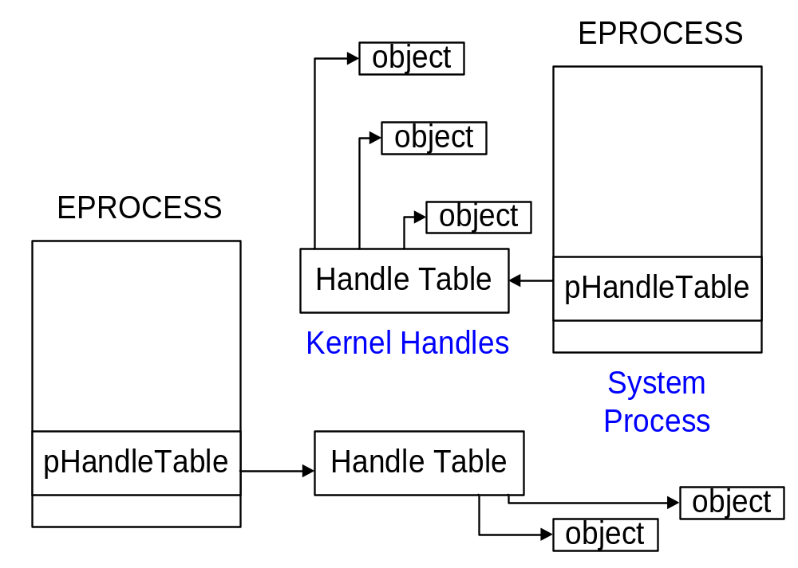
Process Handle Tables

Slide 24
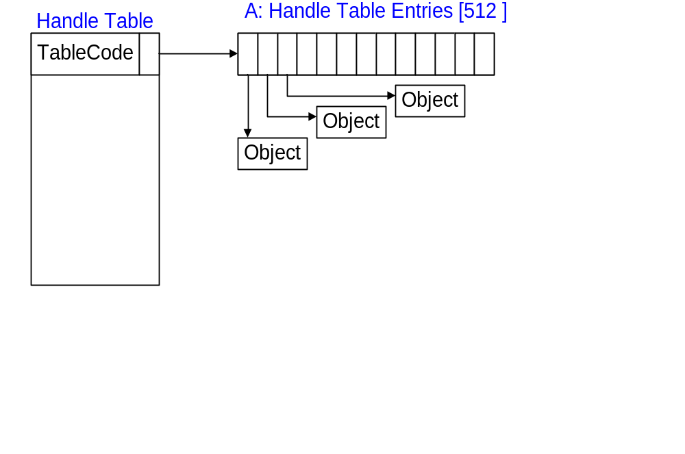
One level: (to 512 handles)

Slide 25
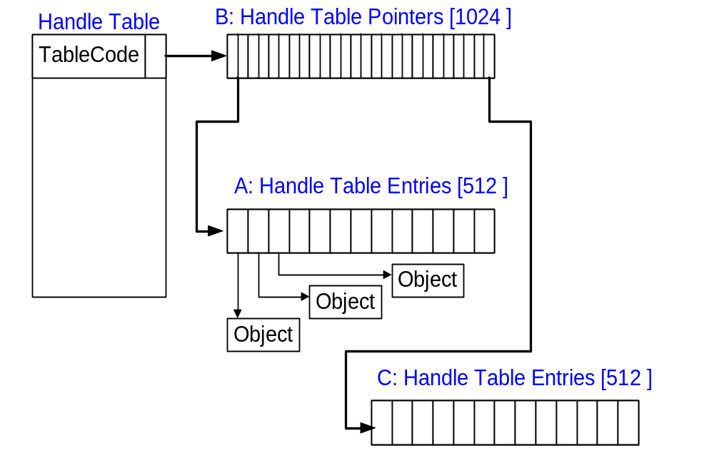
Two levels: (to 512K handles)

Slide 26
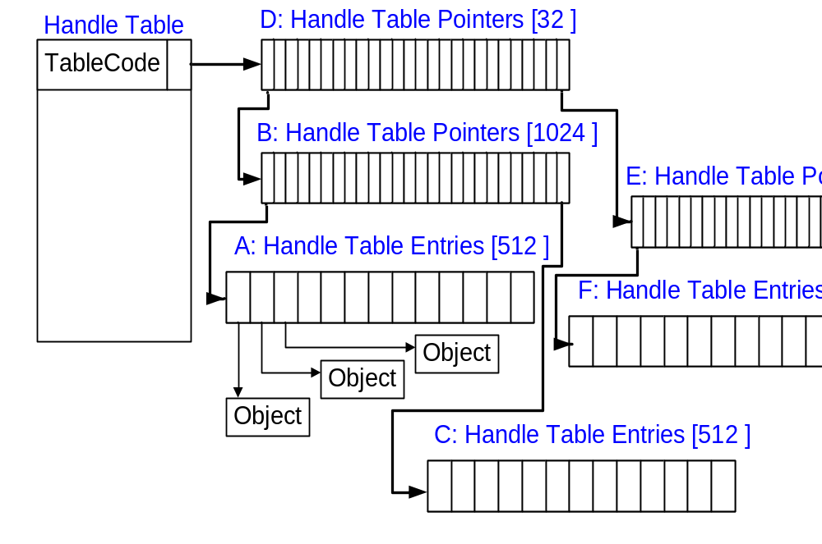
Three levels: (to 16M handles)

Slide 27
Handle Table Data Structure
TablePointer/Level | Points at handles
QuotaProcess | Who to charge
UniqueProcessId | Passed to callbacks
HandleTableLocks[N] | Locks for handles
HandleTableList | Global list of tables
HandleContentionEvent | Event to block on
DebugInfo | Stacktraces
ExtraInfoPages | Parallel table for audits
FirstFree/LastFree | The two handle free lists
NextHandleNeedingPool | Handles w/ memory
HandleCount | Handles in use

Slide 28
Handle Table Functions
ExCreateHandleTable – create non-process tables
ExDupHandleTable – called creating processes
ExSweepHandleTable – for process rundown
ExDestroyHandleTable – called destroying processes
ExCreateHandle – setup new handle table entry
ExChangeHandle – used to set inherit and/or protect
ExDestroyHandle – implements CloseHandle
ExMapHandleToPointer – reference underlying object
ExReferenceHandleDebugInfo – tracing handles
ExSnapShotHandleTables – handle searchers (oh.exe)

Slide 29
ExCreateHandle(table, entry)
NewHandleTableEntry = ExpAllocateHandleTableEntry()
KeEnterCriticalRegionThread()
*NewHandleTableEntry = *HandleTableEntry
ExUnlockHandleTableEntry()
KeLeaveCriticalRegionThread()

Slide 30
Object Manager Summary
Manages the NT namespace
Common scheme for managing resources
Extensible method-based model for building system objects
Memory management based on reference counting
Uniform/centralized security model
Support handle-based access of system objects
Common, uniform mechanisms for using system resources

Slide 31
Lightweight Procedure Calls
Most common local machine IPC
Built for subsystem communication
Local transport for RPC
  RPC also uses named pipes

Slide 32
LPC Architecture
Server process
Kernel Address Space
Client process
Connection Port Handle
Connection port
(named / unnamed)
Server Comm Port
Client Comm Port
Client Comm Handle
Server Comm Handle
Server View of Section
Shared
Section
Client View of Section

Slide 33
LPC ports
Connection port (named / unnamed)
  Created by the server side.
  Used to accept connections, receive requests and to reply to messages
Server communication port
  The server receives a handle to server port each time a new connection is created.
  Used to terminate a connection, to impersonate the client or to reply.
Client communication port
  The client receives a handle to a client port if the connection was successfully accepted.
  Used to request/receive messages

Slide 34
LPC Data Transfer
The message is temporary copied to kernel ( < 256 bytes*)
Using shared sections, mapped in both client and server address spaces
The server can directly read from or write to a client address space

Slide 35
LPC APIs
NtListenPort – server waits for connection request from client (wrapper for NtReplyWaitReceive)
NtAcceptConnectPort – accept/reject client connection request received by NtListenPort
NtCompleteConnectPort – server calls to wake up client after NtAcceptConnectPort
NtConnectPort – used by clients to connect to server ports
NtCreatePort – create a port and give a name in OB namespace
NtImpersonateClientOfPort – used by servers to impersonate client credentials

Slide 36
LPC APIs - 2
NtReplyWaitReceivePort – reply to a message and wait for next message
NtReplyPort – used by clients and servers to reply to messages
NtReplyWaitReplyPort – replies and then waits for a response
NtRead/WriteRequestData – copy message data to/from user buffer
NtRequestPort – send a message
NtRequestWaitReplyPort – send a message and wait for a response

Slide 37
Creating an LPC server
1. Create a named connection port ( NtCreatePort )
2. Create one or more working threads listening to requests on that LPC connection port (NtReplyWaitReceivePort)
{… if ( NtCreatePort(&SrvConnHandle, “LPCPortName”) ) {
CreateThread ( ProcessLPCRequestProc)
} …
}
ProcessLPCRequestProc ()
{ ReplyMsg = NULL;
while (forever_or_so) {
NtReplyWaitReceivePort( SrvConnHandle, ReplyMsg, ReceiveMsg )
DoStuffWithTheReceivedMessage()
ReplyMsg = PrepareTheReply ( IfAny )*
}
}
* Some servers launch a worker thread to process the request and reply to the client

Slide 38
Establishing an LPC connection
The Client initiates a connection (NtConnectPort)
The server receives a connection request message
The server decides to accept/reject the connection and calls NtAcceptConnectPort
The server wakes up the client (NtCompleteConnectPort)
Common Issues
Servers cannot send messages to clients that are not waiting for an LPC message
If a server dies, the client is not notified unless it has threads waiting for a reply
No timeout for the LPC wait APIs

Slide 39
LPC Data Structures
LPC Port (paged)
  Port type, connection & connected port, owning process, server process, port context
LPC Message (paged)
  MessageID, message type, ClientID
Thread LPC fields (non-paged)
  Wait state, request messageID, LCP port, received message id, port rundown queue
Global data
  LpcpNextMessageId, LpcpLock

Slide 40
LPC Port Object
Object fields (name, ref count, type)
Port type (connection, server comm, client comm)
Connection and connected port
Creator CID
Message queue
Port context
Thread rundown queue

Slide 41
LPC Ports in Processes
DebugPort
  used to send debugger messages
ExceptionPort
  CsrCreateProcess assigns it to a win32 process
SecurityPort
  used by lsass (authentication system)
Where are messages found?
  on the caller stack
  in the port queue
  in the thread pending the reply

Slide 42
LPC Message Format
Kernel
Kernel side (Port context, messages list)
User side (PORT_MESSAGE)
  Message type (request, reply, connection request, client died, port closed)
  Message length, data offset
  Client ID
  Message ID
Private data
User mode

Slide 43
PORT_MESSAGE
typedef struct _PORT_MESSAGE {
CSHORT DataLength;
CSHORT TotalLength;
CSHORT Type;
CSHORT DataInfoOffset;
LPC_CLIENT_ID ClientId;
ULONG MessageId;
ULONG CallbackId;
…
// UCHAR Data[];
} PORT_MESSAGE, *PPORT_MESSAGE;

Slide 44
LPC Fields in Threads
LpcReplyChain
  To wake up a client if a server port goes away
LpcReplySemaphore
  It gets signaled when the reply message is ready
LpcReplyMessageId
  The message ID at which the client is waiting a reply
LpcReplyMessage
  The reply message received
LpcWaitingOnPort
  The port object currently used for a LPC request
LpcReceivedMessageId
  The last message ID that a server received

Slide 45
!lpc KD debugger extension
!lpc message [MessageId]
!lpc port [PortAddress]
!lpc scan PortAddress
!lpc thread [ThreadAddr]
!lpc PoolSearch

Slide 46
Discussion

